Slide 1
SMARTSTAY – AI-POWERED HOSTEL MANAGEMENT PLATFORM
2410030440-V Cherishma
2410030349- Anugoju Srija
2410030279-Lakshmi sri
2410030278-S.Amrutha
2410030121-Nelabotla Abhinaya Mohita
2410030260- Sruthika Santosh

Slide 2
Abstraction
SmartStay is an AI-powered hostel management platform. It connects students, wardens, and administrators through one centralized system. Students can view room information, submit complaints, check notices, make payments, and raise maintenance requests. Wardens can manage rooms, students, attendance, complaints, and maintenance. Administrators can monitor hostel activities using dashboards, reports, and analytics. AI/ML can analyze hostel data to predict occupancy, room demand, complaint trends, and maintenance requirements. The system reduces manual work and supports faster, data-driven
decision-making.

Slide 3
PROBLEM STATEMENT
• Manual room allocation can be time-consuming.
• Student records may be maintained using paper or separate systems.
• Complaints may take a long time to reach the responsible person.
• Students may not receive important hostel updates immediately.
• Wardens face difficulty monitoring many students and hostel activitie
• Maintenance is often reactive instead of predictive.
• Hostel data is not effectively analyzed for future planning.
• Existing systems may provide basic management but have limited AI-based decision support.

Slide 4
INTRODUCTION
Hostel management is an important part of educational institutions because it involves managing a large number of students, rooms, facilities, payments, complaints, attendance, visitors, and maintenance activities.
In many institutions, these activities are still handled through manual records, spreadsheets, paper forms, or multiple disconnected systems. This can result in data duplication, delays, communication problems, and difficulty in trackinghostel activities.
With the development of Artificial Intelligence, Machine Learning, cloud computing, and web applications, hostel management can be made smarter and more efficient.
SmartStay brings different hostel activities into a single platform

Slide 5
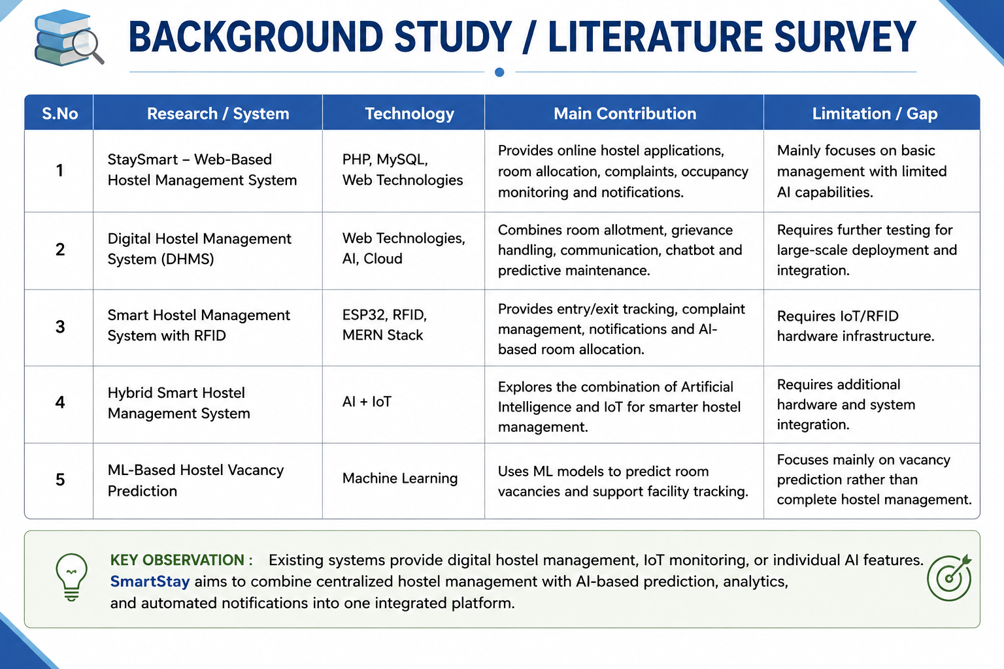
Literature Survey

Slide 6
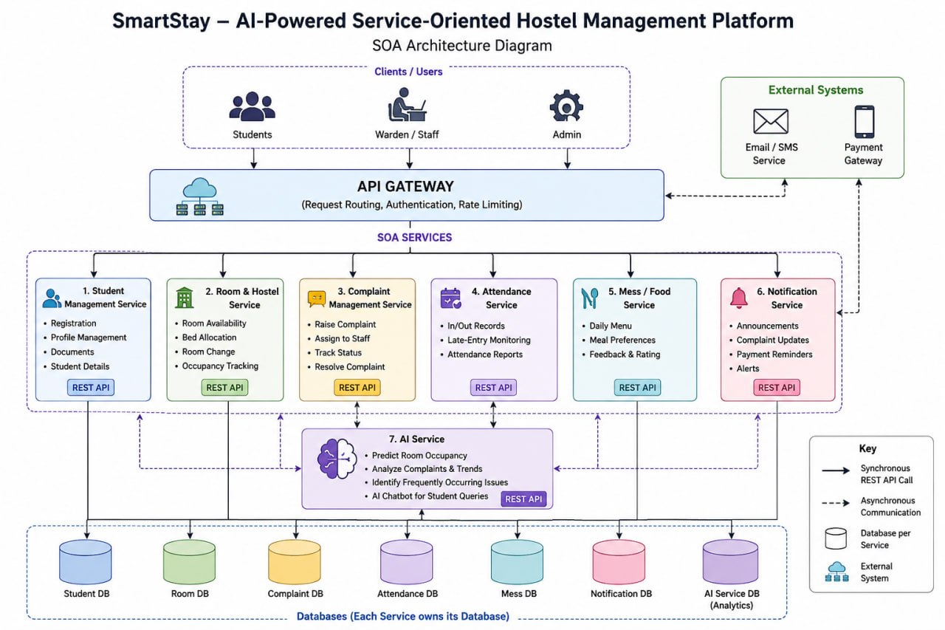

Slide 7
THANK YOU

